Slide 1
Dog shelter presentation
Made by: Tóth róbert, ács norbert

Slide 2
Whatis this site about...
Our website deals with adoptable dogs, offering a wide selection ranging from 8-10 weeks old to 5 years old. With just a few clicks and a phone call, you can pick up your new pet the very next day and give it the home of its dreams.

Slide 3
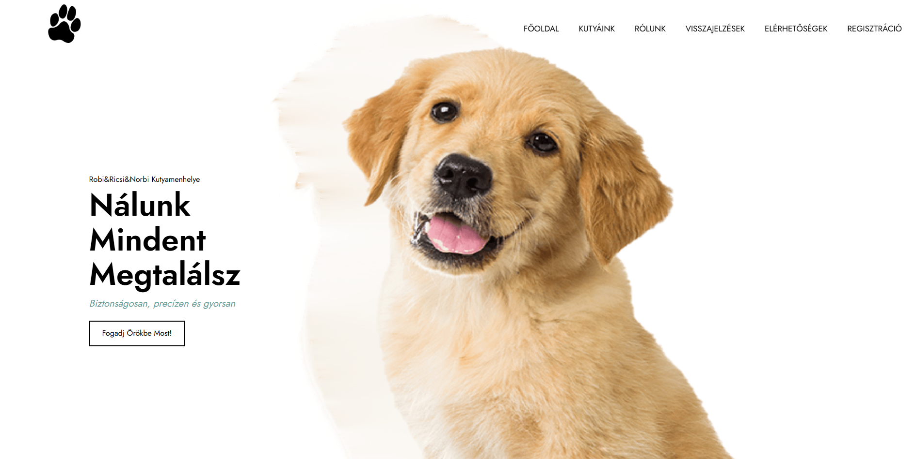
What is this site about...
Notes:
At our shelter, many dogs wait for a new home. You can find puppies from 8–10 weeks old and dogs up to 10 years. At our shelter, you can not only adopt dogs, but also upload dogs who need a new home.
Adoption is easy:
Choose your dog online with a few clicks
Call us to agree on the details
You can come the next day and take your dog home
Give a dog the loving home it dreams of!

Slide 4
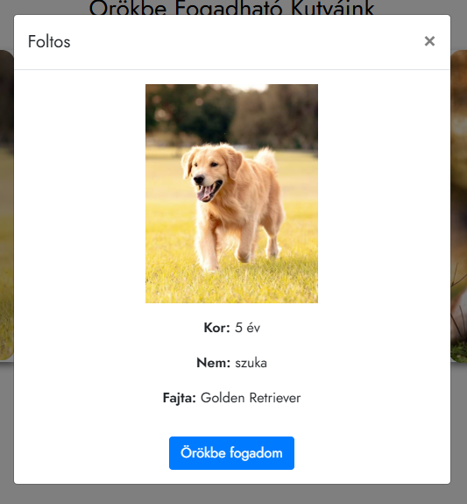
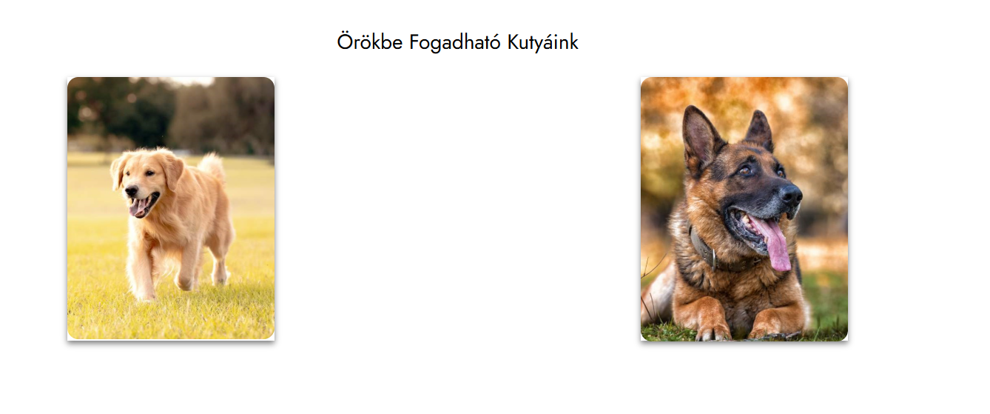
Our Dogs for Adoption
Here you can see our dogs available for adoption
If you click on one of the dogs, it will take you further and show you some information about it. →
Here you can see the details about him, and if you like the dog, you can click on adoption.
As soon as you fill out the form with your information, we will receive the request and review it as quickly as possible and get back to you.

Slide 5
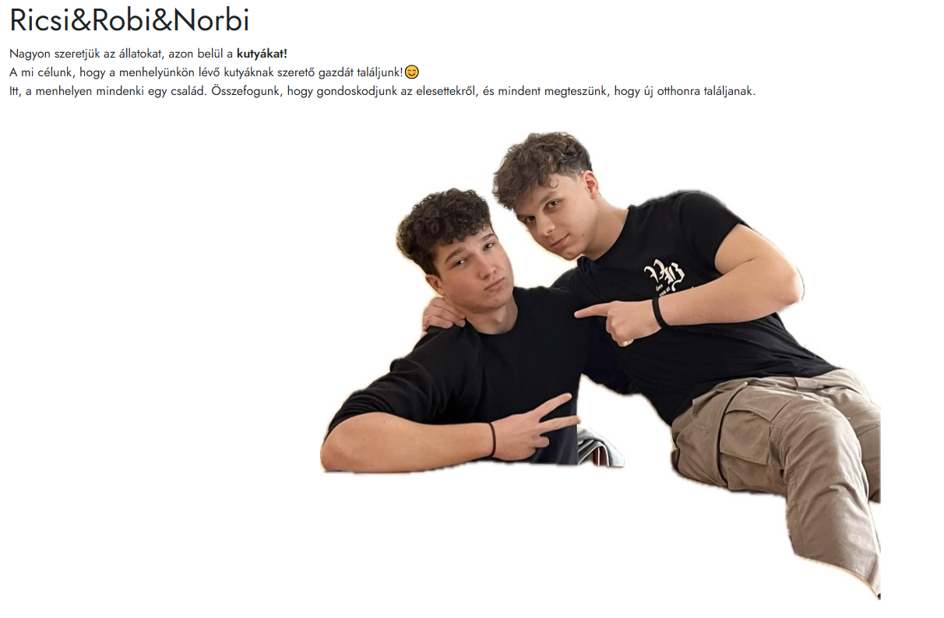
About us
Here you can see a little description about us, our names, what our goal is, and a picture of us. (Norbi is not in the picture yet)

Slide 6
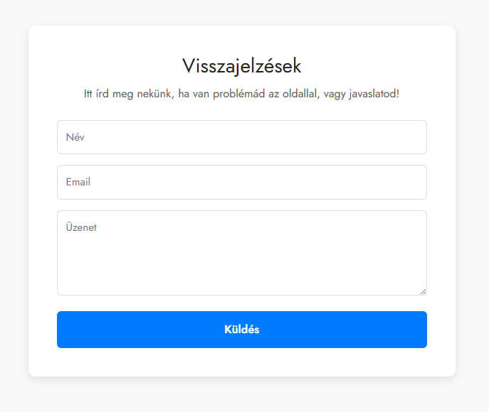
Feedback
Feedback and questions: You can send feedback or a question on our website. When we answer, you will get an email message.

Slide 7
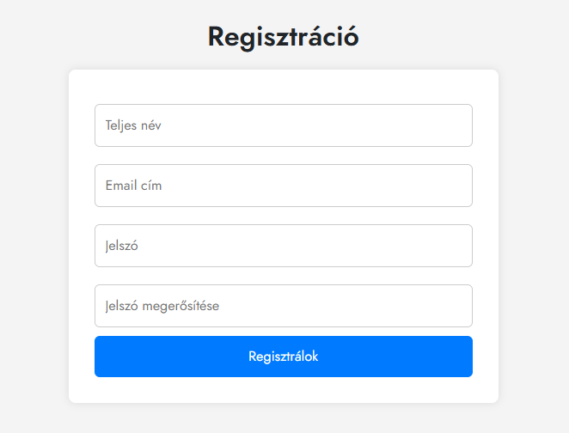
Login and Registration
You can create a new account.
If you have an account, you can log in.
With your account, you can see your dogs, your feedback, and your adoption requests.

Slide 8
THANK YOU FOR YOUR ATTENTION

